Slide 1
Who Are The Hittites?
And why do we care?

Slide 2
A lost Civilization…(not)
Mentioned 47 times in the Bible:
"When the LORD your God brings you into the land that you are entering to take possession of it, and clears away many nations before you, the Hittites, the Girgashites, the Amorites, the Canaanites, the Perizzites, the Hivites, and the Jebusites, seven nations more numerous and mightier than you
Deuteronomy 7:1

Slide 3
Ephron the Hittite
Now Ephron was sitting among the Hittites, and Ephron the Hittite answered Abraham in the hearing of the Hittites, of all who went in at the gate of his city, "No, my lord, hear me: I give you the field, and I give you the cave that is in it. In the sight of the sons of my people I give it to you. Bury your dead”.
Genesis 23:10,11

Slide 4
Uriah the Hittite
And David sent and enquired after the woman. And one said, Is not this Bathsheba, the daughter of Eliam, the wife of Uriah the Hittite?
2 Samuel 11:3

Slide 5
Boğazköy was discovered in 1834 by the French explorer Charles Texier, who saw Yazılıkaya and those remains of the ancient city that were aboveground. After visits by British and German travelers, it was another Frenchman, Ernest Chantre, who in 1892–93 made the first soundings and found the first cuneiform tablets there.

Slide 6
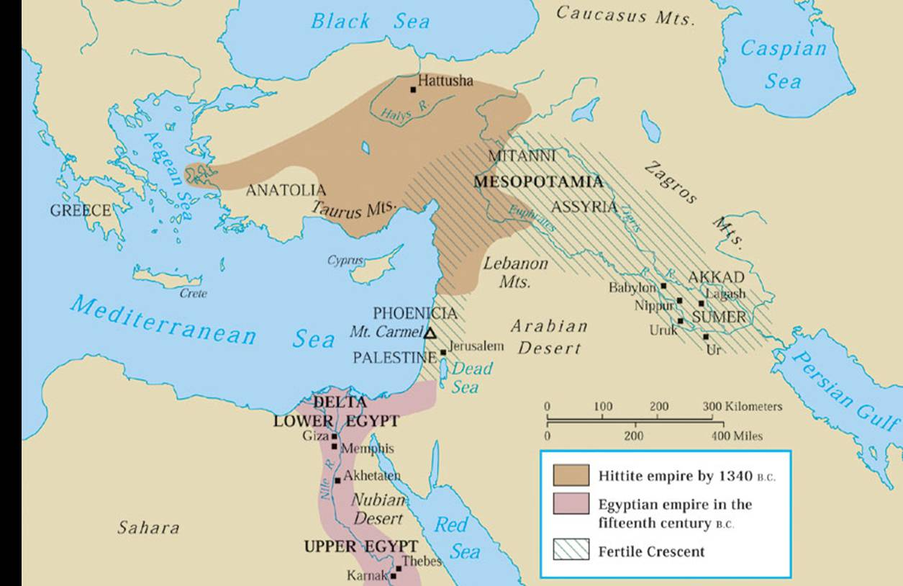

Slide 10
Suzerain treaty between Egypt and Hittites

Slide 11
In the twenty first year on the 21st of Tybi in the reign of Ra user ma Rameses Meriamen came a royal herald from Khetasar the suzerain of the Hittites…It came to pass in the time of Mautenar suzerain of the Hittites my brother that he fought with the great king of Egypt but thus shall it be henceforth from this day Behold Khetasar suzerain of the Hittites covenants to abide by the terms made before the Sun before Set regarding the land of Egypt and the land of the Hittites in order that no quarrel may arise between them for ever. After the death of my brother I Khetasar sat on his father's throne as suzerain of the Hittites.

Slide 12
Covenant Organization.
(1) a preamble, in which the sovereign identified himself and sometimes summarized the covenant itself;
(2) a historical prologue, which gave the historical basis of the covenant, often centered in a great act of deliverance or provision on behalf of the vassal;
(3) the covenant stipulations, which mapped out the requirements that constitute loyalty to the relationship, by which the covenant is maintained;
(4) the covenant blessings or curses contingent on keeping or breaking the covenant; and
(5) the (often divine) witnesses to the covenant.

Slide 13
Deuteronomy. A copy of the Law
Did God use a template or did He make the template?
Preamble Deut. 1:1-8
Prologue Deut. 1:9-3:29
Stipulations Deut. 4-26
Blessings / Curses Deut. 27-30
Witness Deut. 30:11-31:29 (*26) cf 4:26

Slide 14
Can God Get A Witness?
When Moses had finished writing the words of this law in a book to the very end, Moses commanded the Levites who carried the ark of the covenant of the LORD, "Take this Book of the Law and put it by the side of the ark of the covenant of the LORD your God, that it may be there for a witness against you.
Deuteronomy 31:24-26

Slide 15
Witness:
Heaven and Earth Deut. 4:26; 30:19; 31:28
Copy of covenant deposited
in shrine of your god and
In the shrine of my god. Deut. 10:1-5; 31:26
Song Deut. 31:19-21

Slide 16
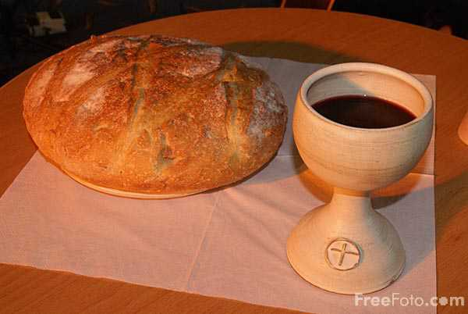
Cut / Celebrate the Covenant
Blood covenant common in Abraham’s time.
Genesis 15 follows a common pattern.
Passover for Jews Exodus 12:7,8,14
Lord’s Supper for Christians. (Acts 2:37-42; Col 2:11-15)
Do this in remembrance of me
1 Corinthians 11:23-28

Slide 17
Practicing Religion or Keeping Covenant?
Christianity is not just one of the world’s great religions…
It is a blood covenant with God.
Whose blood?

Slide 18
Acts 20:28
Pay careful attention to yourselves and to all the flock, in which the Holy Spirit has made you overseers, to care for the church of God, which he obtained with his own blood.

